Slide 1

Multi-scenario Land Surface Temperature projection in Delaware River Basin
Yuewei Shi, Yajie Zeng, Weilai Xu, Chelsea Liu

Slide 2
Content
Introduction
Data and Method
Result
Conclusion
Reference

Slide 3




01
01
Introduction

Slide 4
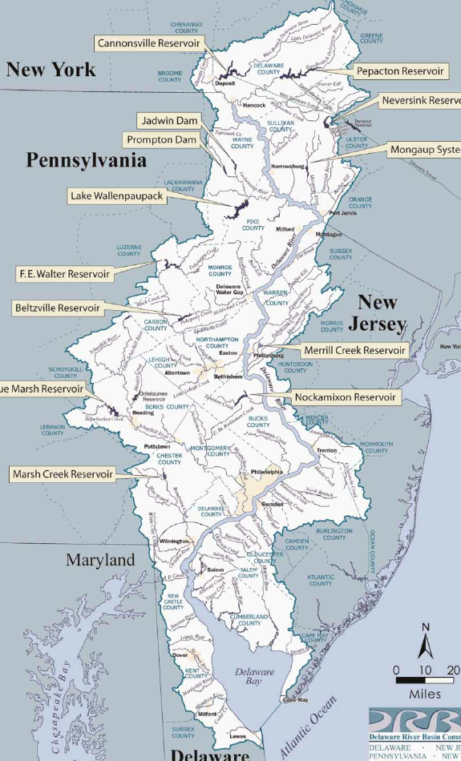
01
Introduction
Through this paper, we will understand the influencing factors and development trends of land surface temperature of Delaware River Basin

Slide 5

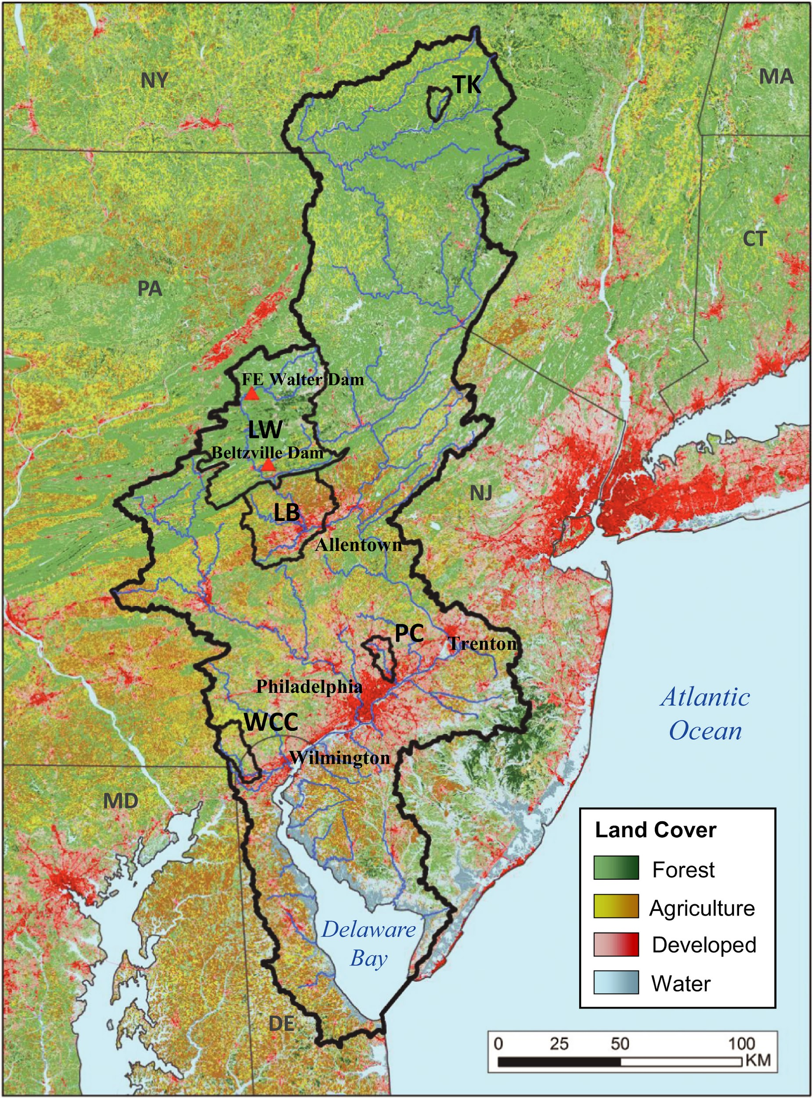
01
Introduction
Study Area—Delaware River Basin
Sensitive to climate change
Temperature could increase by 4.1 to 5.8 degrees by the 2050s and by 5.5 to 9.4 degrees by the 2080s.
Fig 1.1 Delaware River Basin[1]
[1] Hawkins, T. W. & Woltemade, C. J. Impact of projected 21st century climate change on basin hydrology and runoff in the Delaware River Basin, USA. Journal of Water and Climate Change 12, 60–81 (2019).

Slide 6
01
02
Data and Method
Notes:
章节序号可调整
章节装饰小图可自行找图导入替换

Slide 7
02
Data and Method
Method
Target
Features
Training:
2010-2020
LST | DEM | Population | 8 Types of LandUse (%) | Year
Regression:
OLS vs Random Forest
Testing:
2005
OLS Result
vs
RF Result
Prediction:
2050, 2100
Final Model for future LST
LST | DEM | Population | 8 Types of LandUse (%) | Year
Prediction | SSP2 | SSP2 | SSP2
 | SSP3 | SSP3 | SSP3
 | SSP5 | SSP5 | SSP5
Senarios:
SSP2, SSP3, SSP5
Goal!

Slide 8
02
Data and Method
Data Process
Raster Datasets
Features:
Historical & Future
DEM
Population
LandUse
Target:
Historical
LST
Raster Process
Reprojection
Reclassification
ZonalStat
Table Dataset
Grid ID | LST | DEM | Population | 8 Types of LandUse (%) | Year
Dataframe Process
Data Clean
Merge

Slide 9
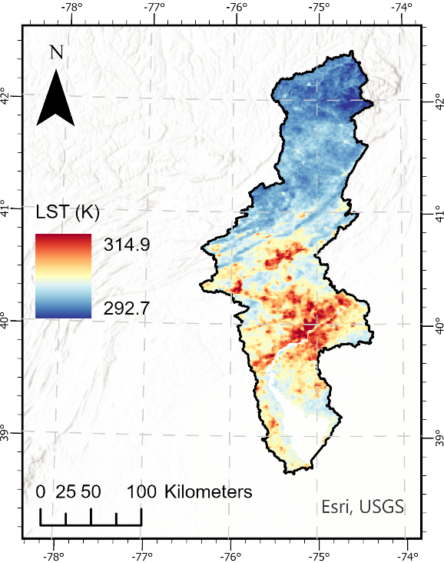
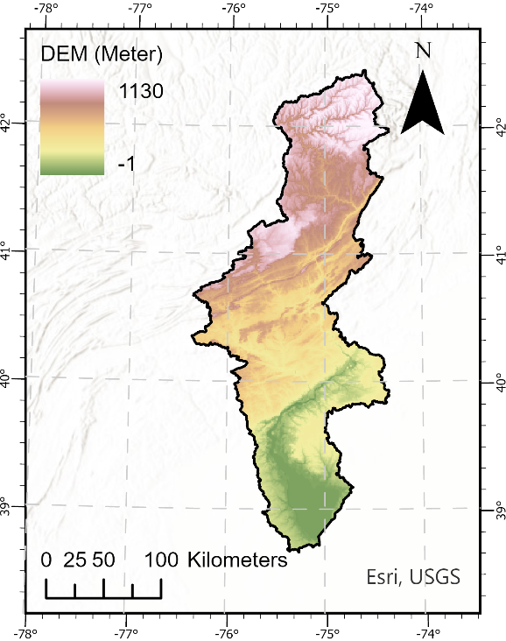
02
Data and Method
LST
DEM
Fig 2.1 Land surface temperature in 2020 summer in Delaware River Basin
Fig 2.2 Land surface temperature in 2020 summer in Delaware River Basin
reprojection
QC bitwise mask to filter out pixels with bad quality
clip by boundary
Zonal Statistics: sum
reprojection
clip by boundary
Zonal Statistics: mean

Slide 10
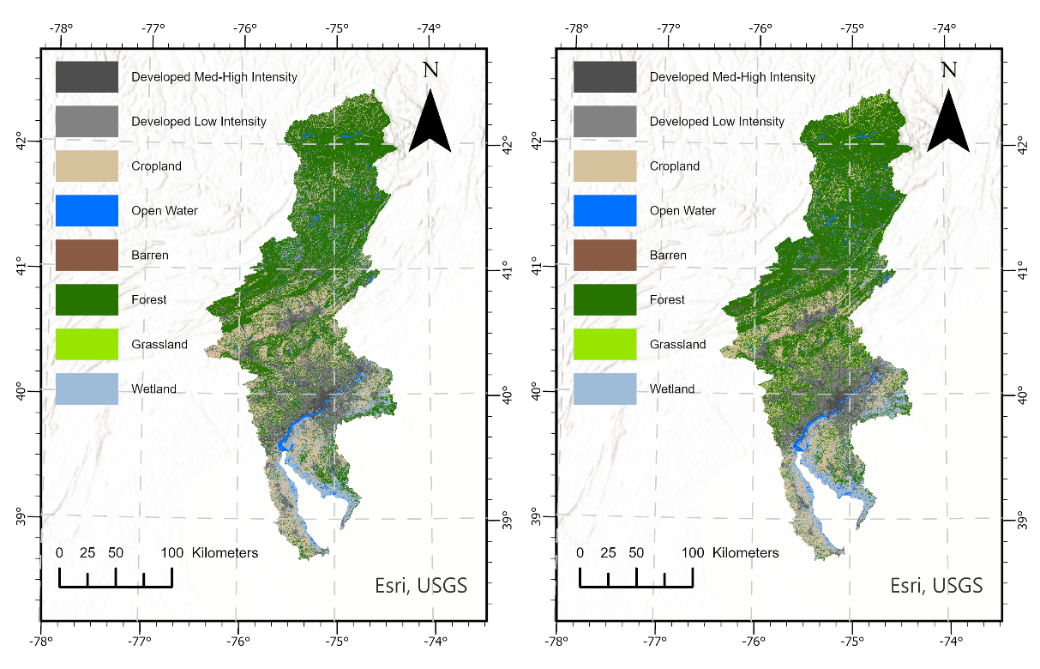
02
Data and Method
LandUse in 2050 under SSP5
LandUse Historical
Fig 2.3 Landuse in 2021 (Right) and predicted landuse in 2050 in Delaware River Basin under SSP5 (Left)
reprojection
clip by boundary
reclassification
Tabulate Area: Calculate area for each grid in fishnet

Slide 11
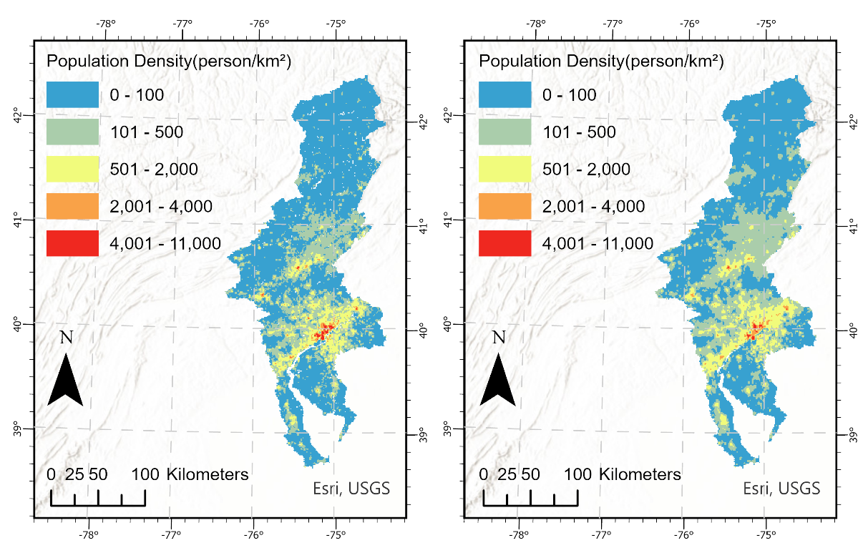
02
Data and Method
Population Historical
Population in 2050 under SSP5
Fig 2.4 Polulation density in 2021 (Right) and predicted in 2050 in Delaware River Basin under SSP5 (Left)
reprojection
clip by boundary
Zonal Statistics: sum

Slide 12
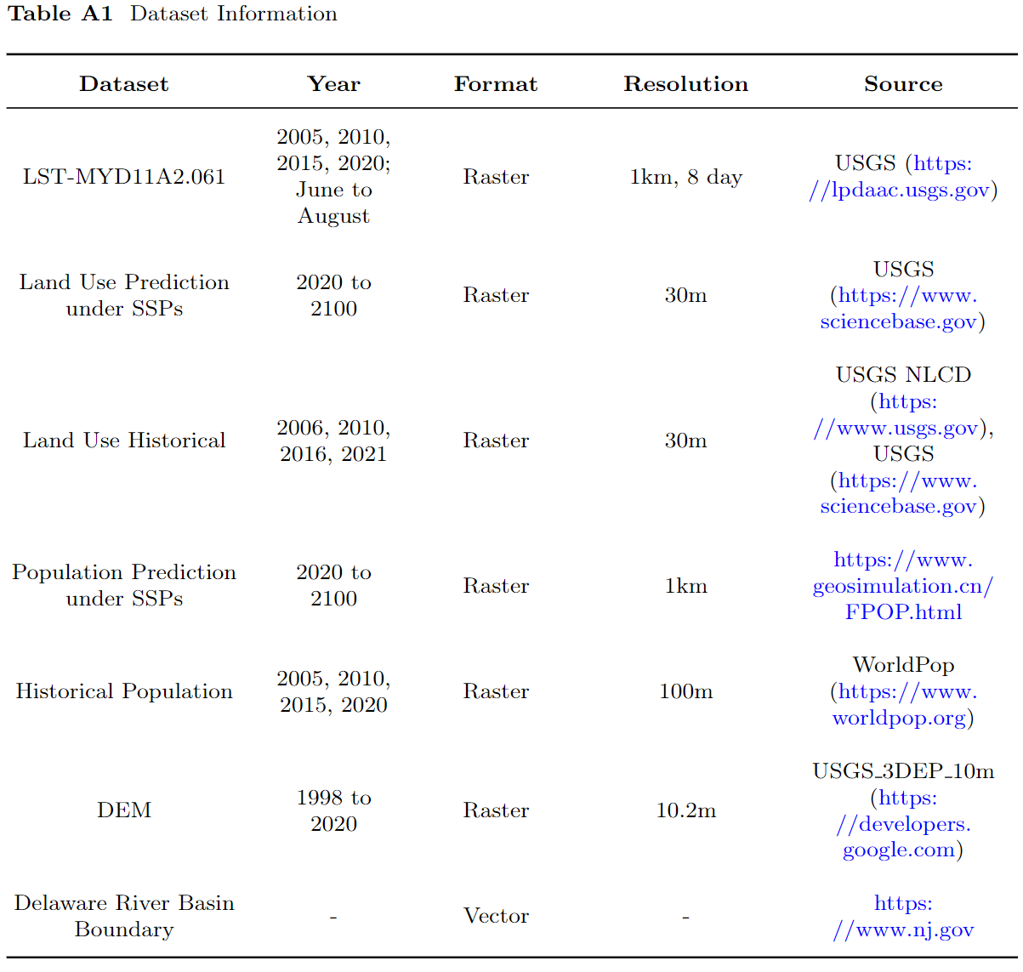
02
Data and Method

Slide 13
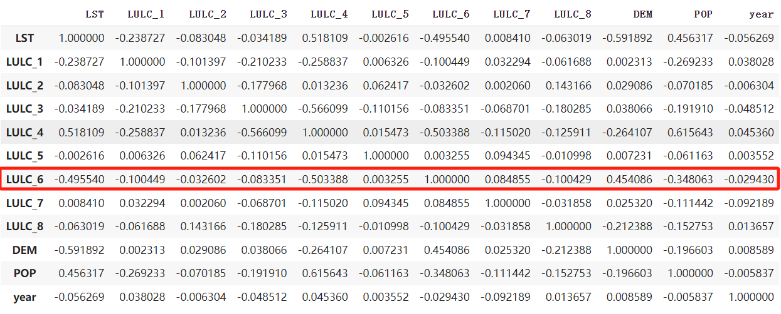
02
Data and Method
Pearson correlation coefficients Analysis

Slide 14
02
Data and Method
VIF
Population | DEM | Year | Cropland | Open Water | Developed Low Intensity | Developed Med-High Intensity | Barren | Grassland | Wetlands
1.7349620 | 1.3294560 | 1.0154654 | 1.6813427 | 1.1085648 | 2.8581868 | 3.8103408 | 1.0340526 | 1.0929477 | 1.4691625

Slide 15
01
03
Result

Slide 16
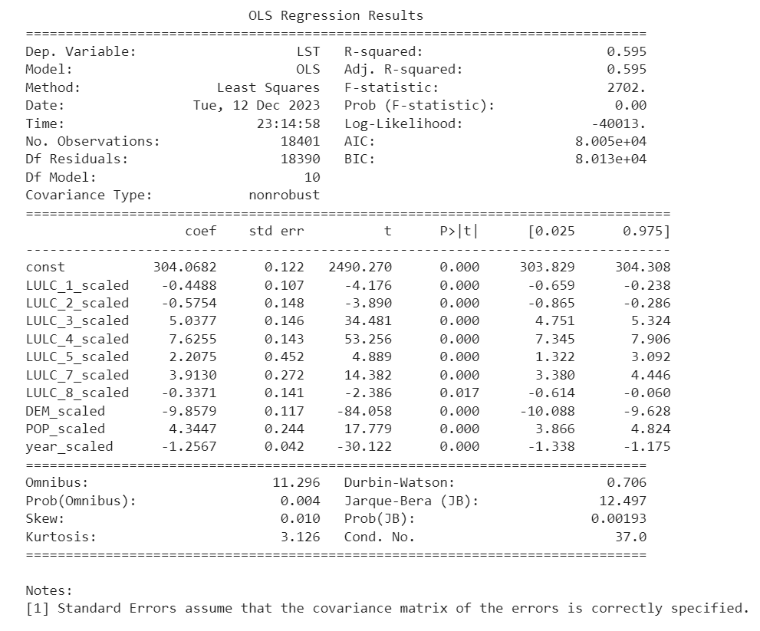
03
OLS Regression

Slide 17
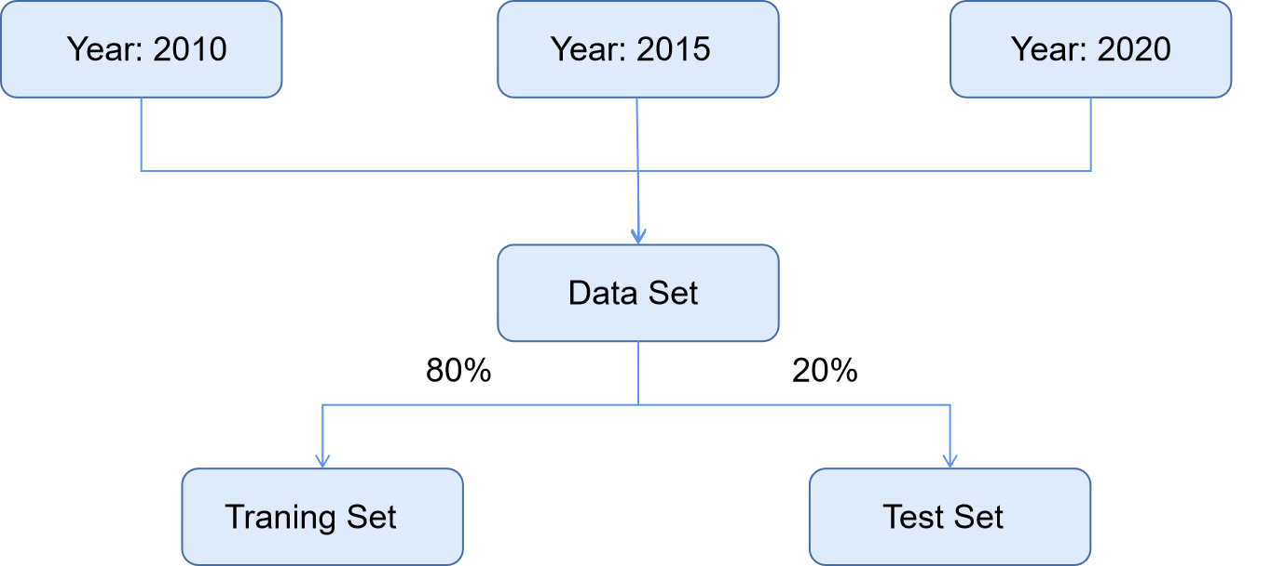
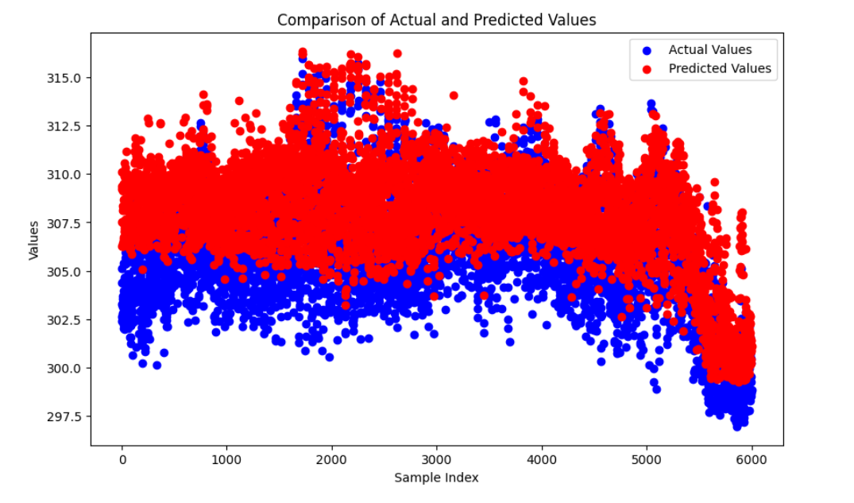
03
Random forest
Build a model
Comparison of actual and forecast values for 2005

Slide 18
03
Model Selection
 | OLS | RF
R2 | 0.4800 | 0.2509
MAE | 1.7514 | 2.1661
RMSE | 2.2017 | 2.6427
MSE | 4.8475 | 6.9837
Finally, this paper selected OLS model for future prediction

Slide 19
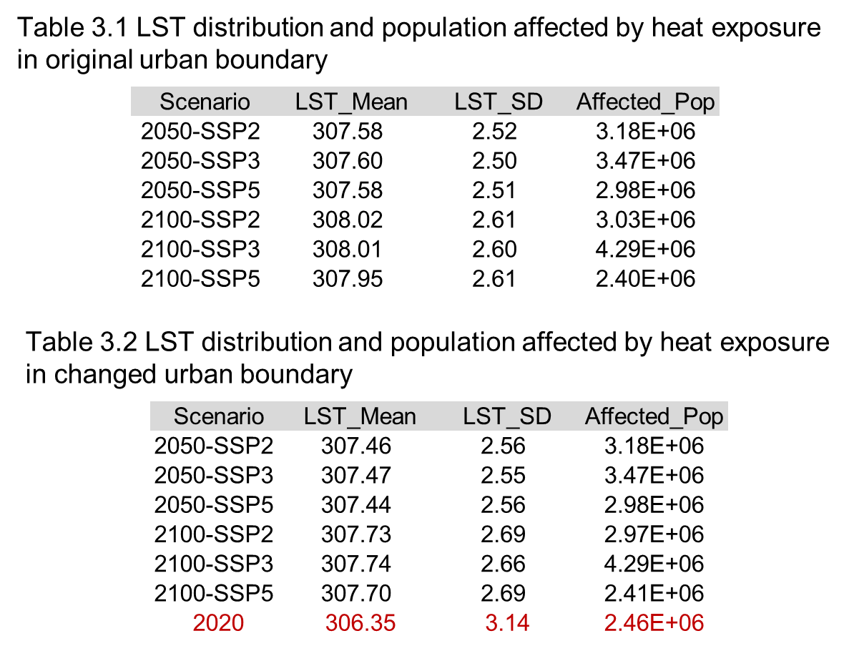
03
Model Result

Slide 20
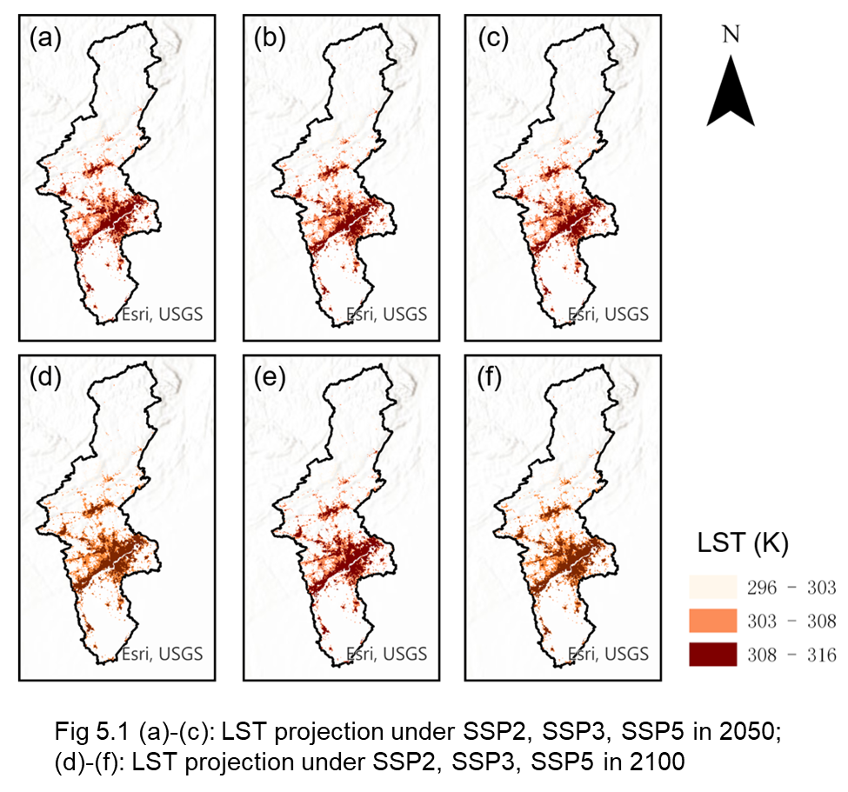
03
Model Result

Slide 21
01
04
Conclusion

Slide 22
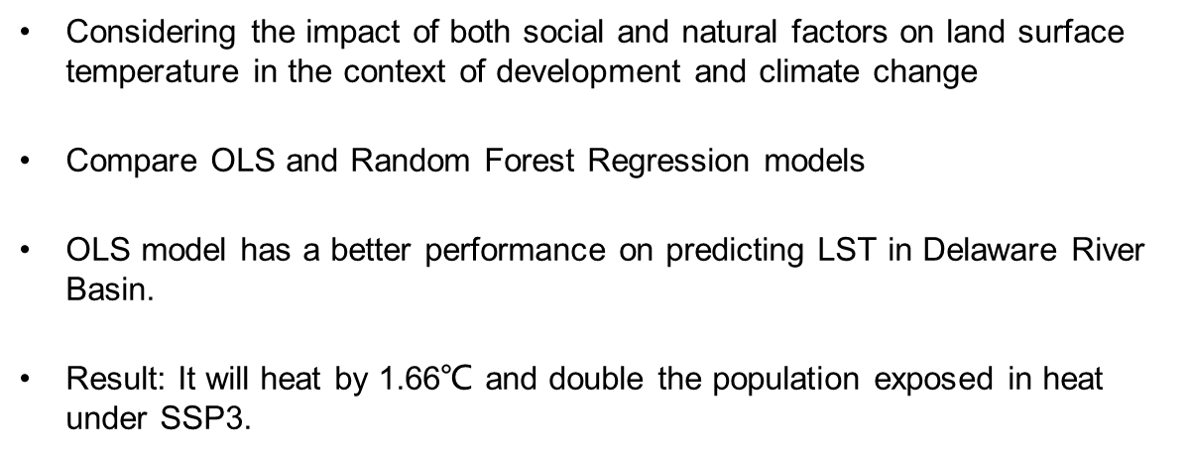
04
Conclusion

Slide 23
05
References
[1] Yao Yuan, Chen Xi, Qian Jing, Research progress on the thermal environment of the urban surfaces. Acta Ecologica Sinica
38(3) (2018) https://doi.org/10.5846/stxb201611022233 . Accessed 2023-12-13
[2] He, B.-J., Wang, J., Zhu, J., Qi, J.: Beating the urban heat: Situation, background, impacts and the way forward in China. Renewable and Sustainable Energy Reviews161, 112350 (2022) https://doi.org/10.1016/j.rser.2022.112350 .Accessed 2023-12-13
[3] Zhou, L., Yuan, B., Hu, F., Wei, C., Dang, X., Sun, D.: Understanding the effects of 2D/3D urban morphology on land surface temperature based on local climate 13 zones. Building and Environment 208, 108578 (2022)https://doi.org/10.1016/j.buildenv.2021.108578 . Accessed 2023-12-13
[4] Brans, K.I., Engelen, J.M.T., Souffreau, C., De Meester, L.: Urban hot-tubs:Local urbanization has profound effects on average and extreme temperature sin ponds. Landscape and Urban Planning176, 22–29 (2018) https://doi.org/10.1016/j.landurbplan.2018.03.013 . Accessed 2023-12-13
[5] Geng, X., Yu, Z., Zhang, D., Li, C., Yuan, Y., Wang, X.: The influence of local background climate on the dominant factors and threshold-size of the cooling effect of urban parks. Science of The Total Environment 823, 153806 (2022)https://doi.org/10.1016/j.scitotenv.2022.153806 . Accessed 2023-12-13
[6] Noi, P.T., Degener, J., Kappas, M.: Comparison of Multiple Linear Regression,Cubist Regression, and Random Forest Algorithms to Estimate Daily Air Surface Temperature from Dynamic Combinations of MODIS LST Data. Remote Sensing9(5), 398 (2017) https://doi.org/10.3390/rs9050398 . Number: 5 Publisher:Multidisciplinary Digital Publishing Institute. Accessed 2023-12-13
[7] Kashki, A., Karami, M., Zandi, R., Roki, Z.: Evaluation of the effect of geographical parameters on the formation of the land surface temperature by applying OLS and GWR, A case study Shiraz City, Iran. Urban Climate 37, 100832 (2021)https://doi.org/10.1016/j.uclim.2021.100832 . Accessed 2023-12-13
[8] Chen, H., Zhao, L., Cheng, L., Zhang, Y., Wang, H., Gu, K., Bao, J., Yang,J., Liu, Z., Huang, J., Chen, Y., Gao, X., Xu, Y., Wang, C., Cai, W., Gong,P., Luo, Y., Liang, W., Huang, C.: Projections of heatwave-attributable mortality under climate change and future population scenarios in China. The Lancet Regional Health. Western Pacific 28, 100582 (2022) https://doi.org/10.1016/j.lanwpc.2022.100582
[9] Chen, M., Chen, L., Zhou, Y., Hu, M., Jiang, Y., Huang, D., Gong, Y., Xian, Y.:Rising vulnerability of compound risk inequality to ageing and extreme heatwave
[10] Lan, T., Peng, J., Liu, Y., Zhao, Y., Dong, J., Jiang, S., Cheng, X., Corcoran,J.: The future of China’s urban heat island effects: A machine learning based scenario analysis on climatic-socioeconomic policies. Urban Climate 49, 101463(2023) https://doi.org/10.1016/j.uclim.2023.101463 . Accessed 2023-12-13
[11] Hawkins, T.W., Woltemade, C.J.: Impact of projected 21st century climate change on basin hydrology and runoff in the Delaware River Basin, USA. Journal of Water and Climate Change 12(1), 60–81 (2019) https://doi.org/10.2166/wcc.2019.140 . Accessed 2023-12-13
[12] Dornbierer,J.C.M.,Wika,S.C.,Robison,C.J.,Rouze,G.S.,Sohl,T.L.:Long-term database of historical,current,and future landcover for the Delaware River Basin(1680 through 2100).U.S.Geological Survey (2021). https://doi.org/10.5066/P93J4Z2W . https://www.sciencebase.gov/catalog/item/605c987fd34ec5fa65eb6a74 Accessed 2023-12-13
[13] Li, M., Zhou, B.-B., Gao, M., Chen, Y., Hao, M., Hu, G., Li, X.: Spatiotemporal dynamics of global population and heat exposure (2020–2100): based on improved SSP-consistent population projections. Environmental Research Letters 17(9),094007 (2022) https://doi.org/10.1088/1748-9326/ac8755 . Accessed 2023-10-22 17

